Slide 1
Professional Financial Reports with {rmarkdown}
Brad Lindblad, MBA
bradley.lindblad@gmail.com
Technistema.com
Repo:
https://github.com/bradlindblad/pro_reports_talk

Slide 2




Key players

Slide 3
Disclaimers:
Rmarkdown / pandoc / TeX can cause pain
Use {renv} : > renv::restore()
  Potentially, tinytex::reinstall_tinytex()
  More troubleshooting at the Github README
Tested on:
  Windows 10
  Linux Mint 20 (may need to install magick++ with apt
  Mac OS

Slide 4
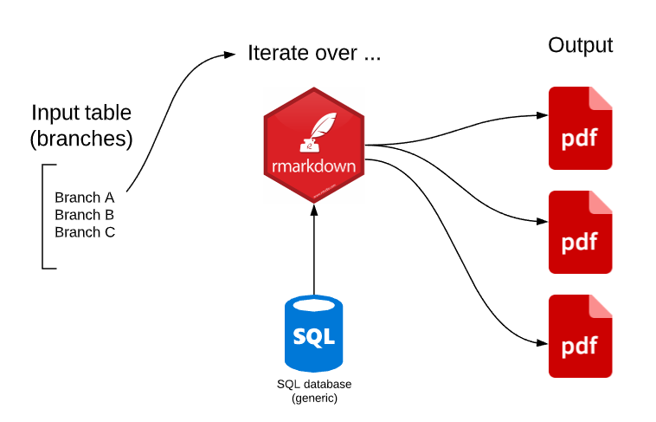

Slide 5
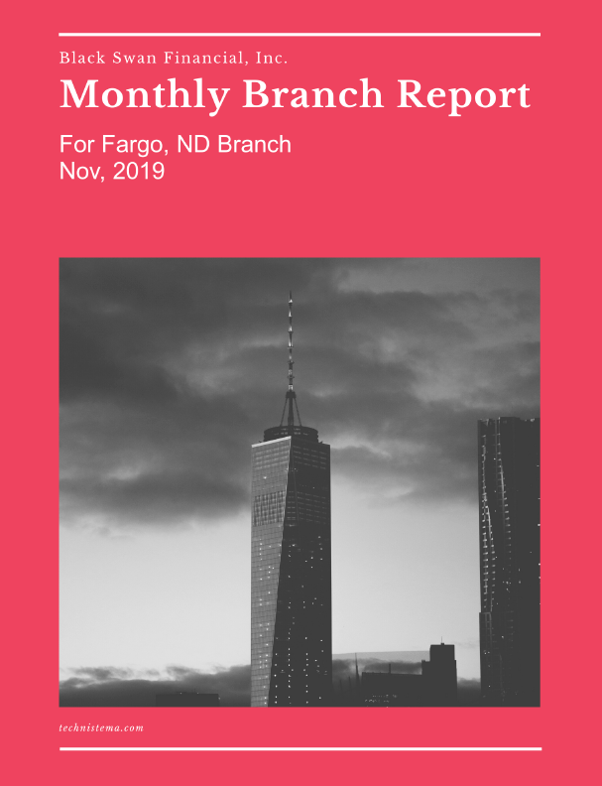

Slide 6
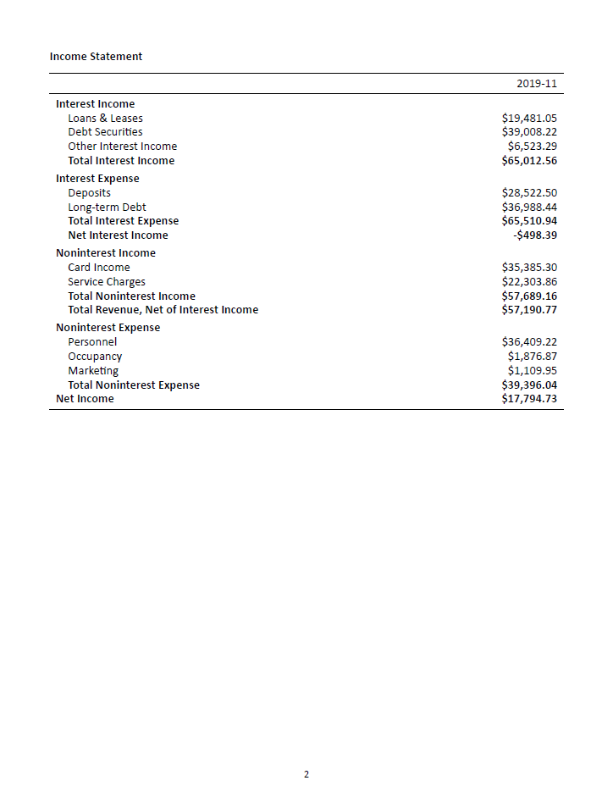

Slide 7
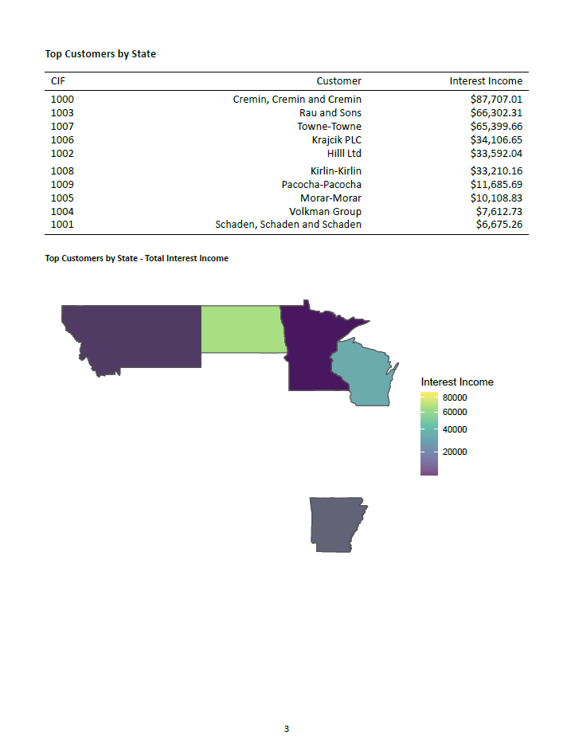

Slide 8
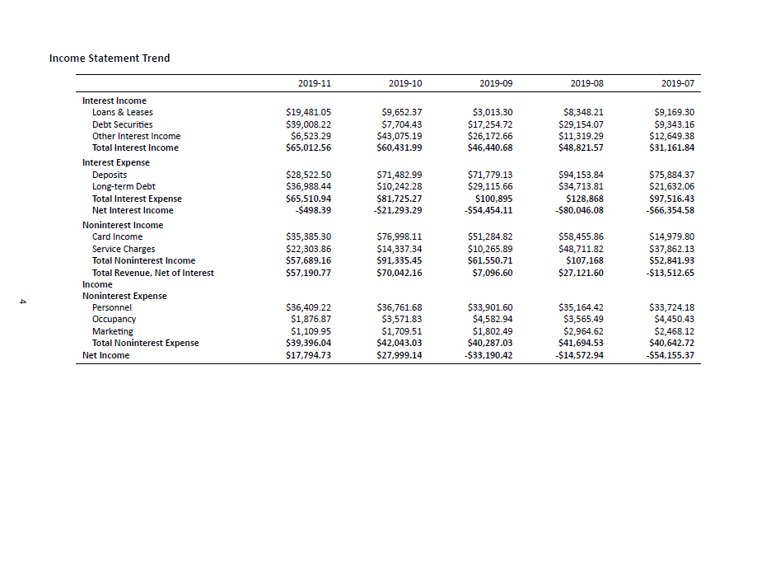

Slide 10
Use it:
Use my example repo to:
  Pick off Excel reports
  Make your own reporting easier
  Automate the boring and error-prone stuff

